Slide 1

xLLM: New Generation of Large Language Models Vincent Granville, PhD Chief AI Scientist GenAItechLab.com vincentg@mltechniques.com May 29, 2024
Fast, High Performance Multi-LLM System Without Neural Network

Slide 2
Extreme LLM (xLLM) in a Snapshot
Mixture of experts
One specialized, small sub-LLM per top category
LLM router (multi-agent system) to manage the sub-LLMs
User selects top category and hyperparameters
Each sub-LLM built with its own taxonomy and knowledge graph
No neural network, no training
Thus, low cost, easy to fine-tune (in milliseconds per sub-LLM)
Self-tuned based on favorite hyperparameters, and customizable
No GPU, no latency, better results, local implementation

Slide 3
Extreme LLM (xLLM) in a Snapshot
Concise results
Multiple sections displayed to user: links, related content, x-embeddings
Output with relevancy score attached to each item in each section
Supports bulk queries, output saved to file
Great for search, targeted to busy professional users and experts
Case studies
Corporate corpus with augmented sources (content + taxonomies)
Wolfram corpus: 15 sub-LLMs, 500 sub-categories per sub-LLM
Publisher, 4000 titles: clustering, predicting article performance

Slide 4
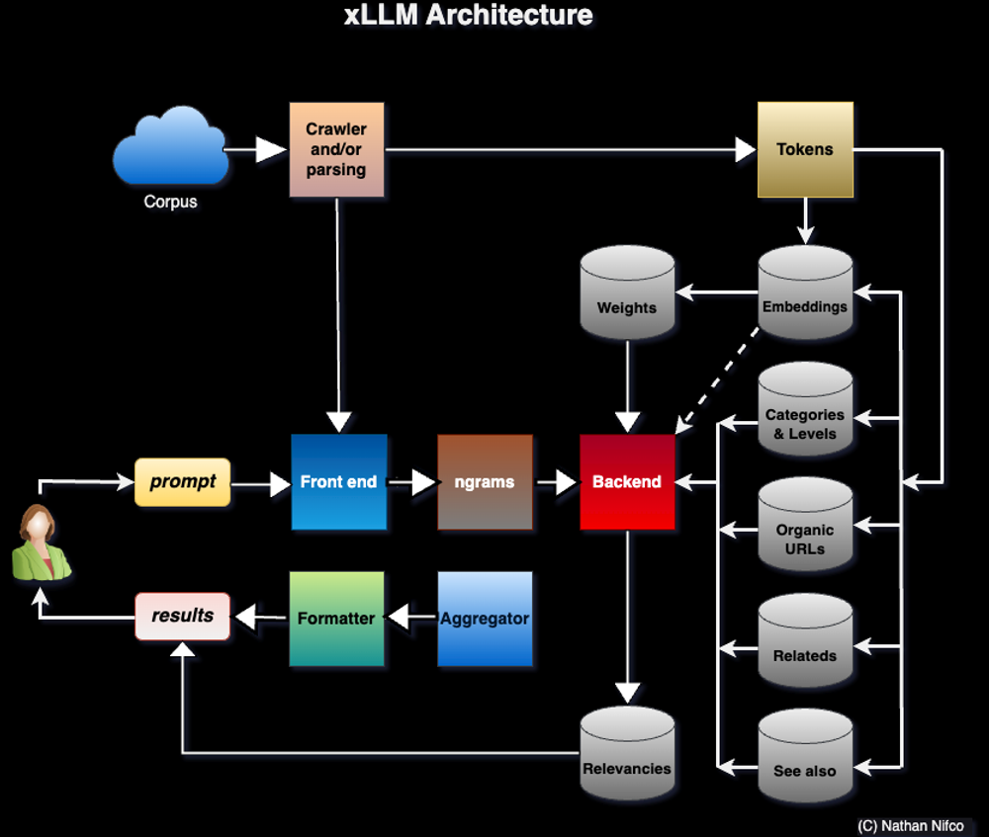
Sub-LLM Architecture

Slide 5
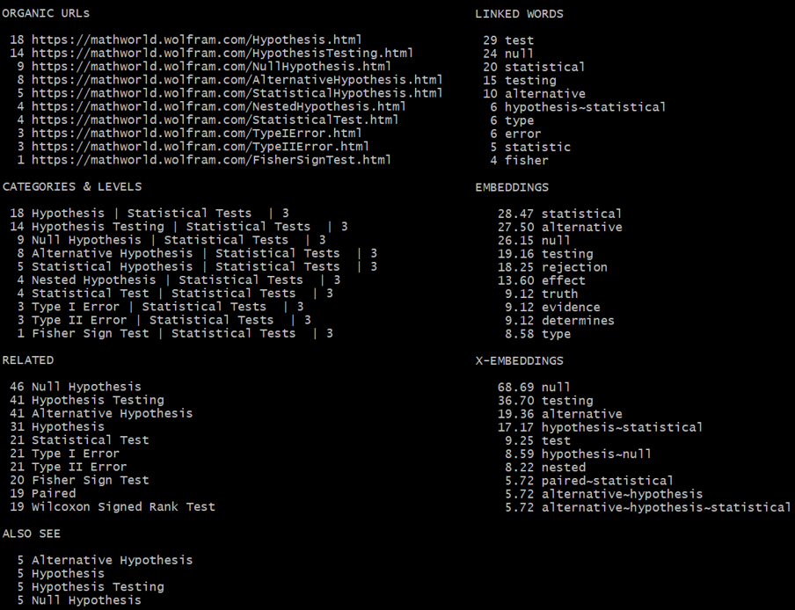
Output: KW = Hypothesis, Sub-LLM = Stats

Slide 6
Sub-LLM Components
Smart crawling to retrieve embedded structure
Breadcrumbs (enterprise corpus), concept associations (related links)
Metadata, tags, taxonomy (category graph)
Augmented with user prompts
Augmented with books (TOC, index, glossaries, synonyms, titles)
X-embeddings
Variable-length embeddings stored as sparse nested hashes
Multi-token: “data~science” on top of single tokens “data” and “science”
Contextual token: “data^science”, both words in same paragraph but not adjacent
PMI (pointwise mutual information) instead of dot product / cosine distance
Parametric weights attached to tokens (no loss function to optimize)

Slide 7
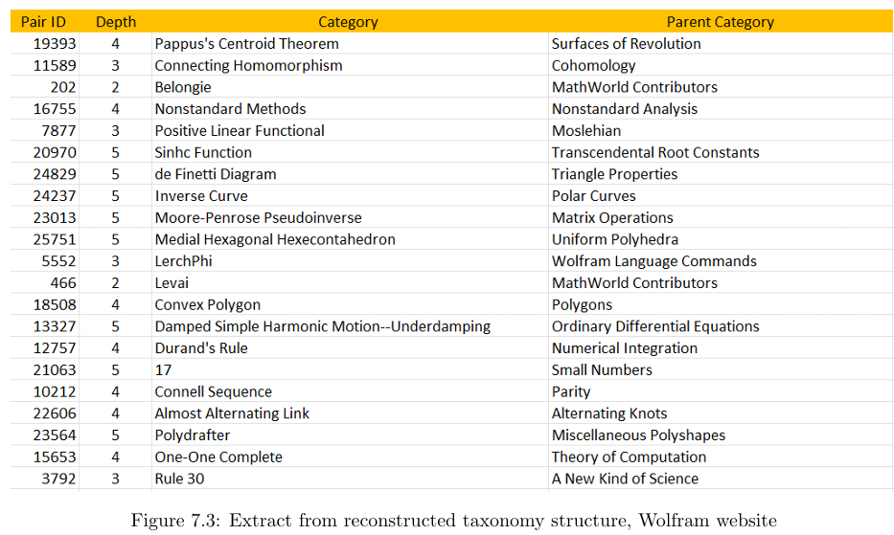
Extract from Taxonomy Graph

Slide 8
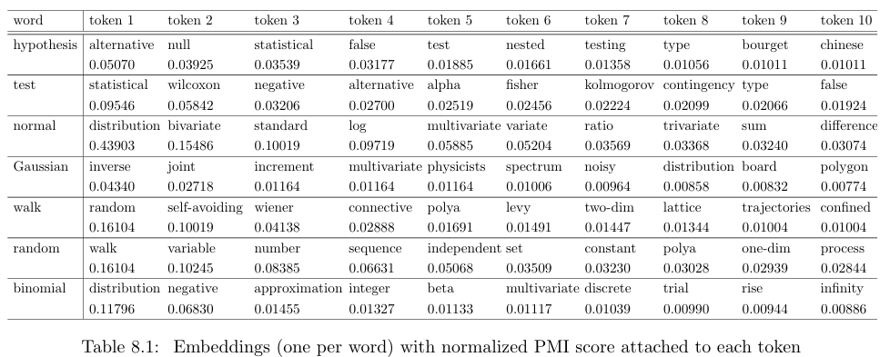
Extract from Embedding Table

Slide 9
Sub-LLM Components (Cont.)
Home-made libraries
Issues with Python libraries (singularize, autocorrect, “Feller” changed to “seller”)
Minimize stemming and text transforms; keep plural if found in corpus
Important: accented characters, separators (punctuation), capital letters
Ad-hoc lists: home-made stopwords, do not singularize, do not autocorrect
Backend tables (specific to each sub-LLM)
X-embeddings not the most important table; taxonomy more important
Compressed n-grams: key to n-gram table is ordered n-gram (“learning machine”); value = list of n-gram permutations found in corpus (“machine learning”)

Slide 10
Sample Entry from Taxonomy Table
Example:
central~limit {‘Lindeberg Condition | Limit Theorems | 4’ : 1, ‘Lyapunov Condition | Limit Theorems | 4’ : 2}
Explanations:
Key: “central~limit”, a word found in the corpus
Value: hash table with comma-separated key-value pairs (nested key-value)
Nested key has 3 elements: category, parent category, and category level for parent category (depth); these elements are separated by the | symbol
The value attached to a nested key, after the colon symbol, is the number of times the word in question is found on a webpage with the category in question

Slide 11
Sub-LLM Components (Cont.)
Fast Approximate Nearest Neighbor Search
With caching, variable-length embeddings, and compressed n-grams for faster search
Goal: find embeddings in backend tables, similar to those detected in user prompt
Synonyms dictionary and abbreviations map. Built on glossaries, indexes, etc. For instance, map “ANOVA” to “Analysis of Variance”
LLM Router. Example: “gradient descent” prompt word not found in the “Statistics” sub-LLM; reroute to the “Calculus” sub-LLM to retrieve items relevant to the prompt.
Augmented taxonomy
When crawled taxonomy is poor, use external taxonomy or build one from scratch
Use taxonomy entries as regular text in embeddings, with higher weight

Slide 12
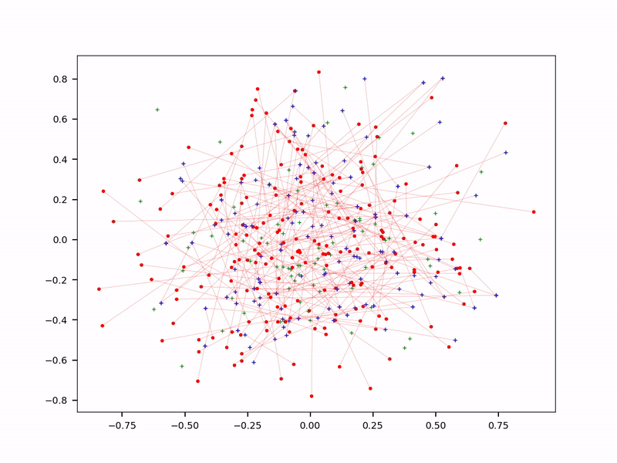
Fast Approximate Nearest Neighbor Search
Red dot: user-derived embedding
Blue dot: backend table embedding
Over time, arrows link red dots to their nearest blue dots

Slide 13
Evaluation
User-based (automated)
Collect favorite hyperparameters chosen by users
Use smart grid search to set default hyperparameters based on user favorites
Fine-tune on one or few sub-LLMs (like LoRA) before full optimization on (say) 200 sub-LLMs. You may fine-tune all sub-LLMs in parallel.
Taxonomy-based (automated)
Pretend that the taxonomy backend table comes from external sources
Assign categories to webpages based on this “external” taxonomy
For each webpage, compare externally assigned to native category

Slide 14
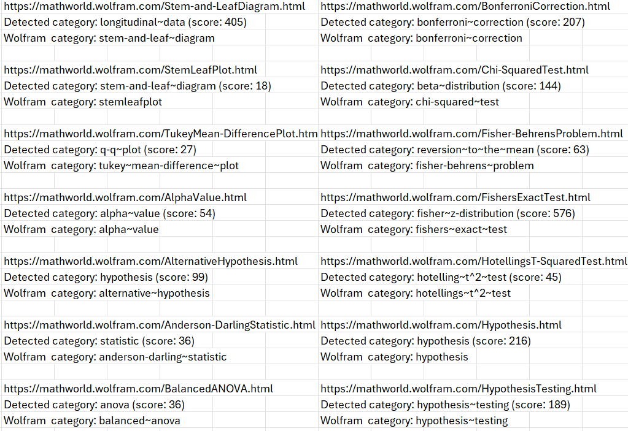
Taxonomy-Based Evaluation

Slide 15
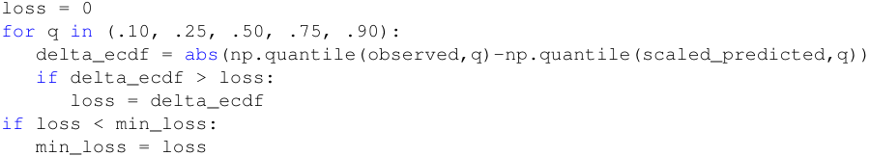
xLLM for Predictions
Case study
Predicting article pageviews based on title keywords and category
4000 articles; pageview is normalized and time-adjusted
Evaluation and Loss function (identical)
Based on comparing predicted with observed quantiles
Using 5 quantiles (see code)
Good proxy to Kolmogorov-Smirnov distance

Slide 16
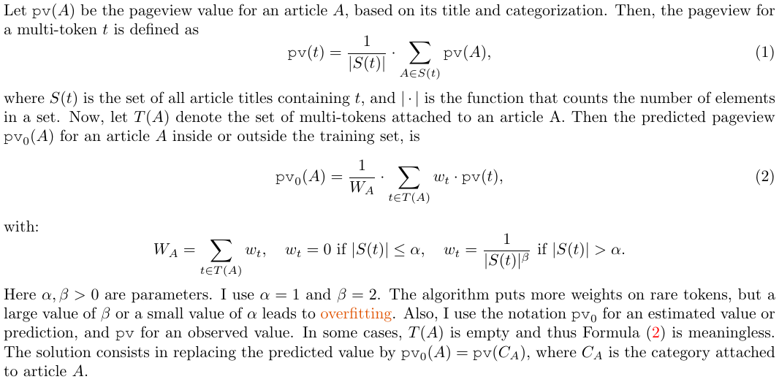
xLLM for Predictions – Model

Slide 17
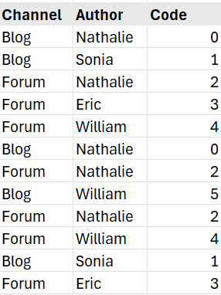
Smart Encoding of Categorical Features
Create new codes sequentially as you browse the training set.
Aggregate codes with few observations into bundles.
Create two key-value mappings. Ex:
Category_to_Code[‘Blog’, ‘William’] = 5
Code_to_category[5] = [‘Blog’, ‘William’]
Replace the categorical features by the newly created feature, “Code”.
Number of codes ≤ number of obs.

Slide 18
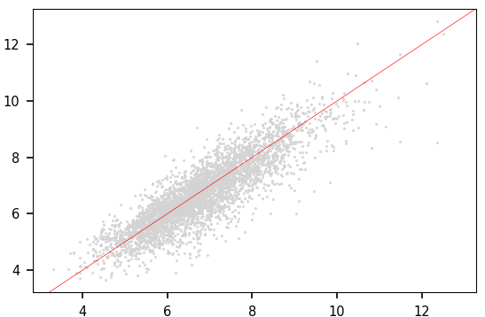
xLLM for Predictions – Results
Scatterplot, observed vs predicted pv
Predicted pv (pageview) adjusted due to small prediction bias

Slide 19
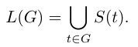
xLLM for Clustering
Case study
Identifying patterns / clusters in popular articles based on title keywords
4000 articles; pageview is normalized and time-adjusted
Methodology
Group multi-tokens into clusters based on a similarity metric, with hierarchical clustering and k-medoids
Let S(t) be the set of articles containing the multi-token t in the title
For each multi-token group G, the list L(G) of articles belonging to G is

Slide 20
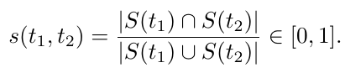
xLLM for Clustering
Similarity between two multi-tokens t₁, t₂
Remarks
Multi-token clusters are non-overlapping, but article clusters may overlap
Sklearn clustering methods require a distance matrix as input; the matrix (derived from the similarity metric) is huge but extremely sparse.
In my implementation, s(t₁, t₂) is computed and stored only if it is strictly positive. Using connected components for clustering, it is far more efficient than Sklearn.

Slide 21
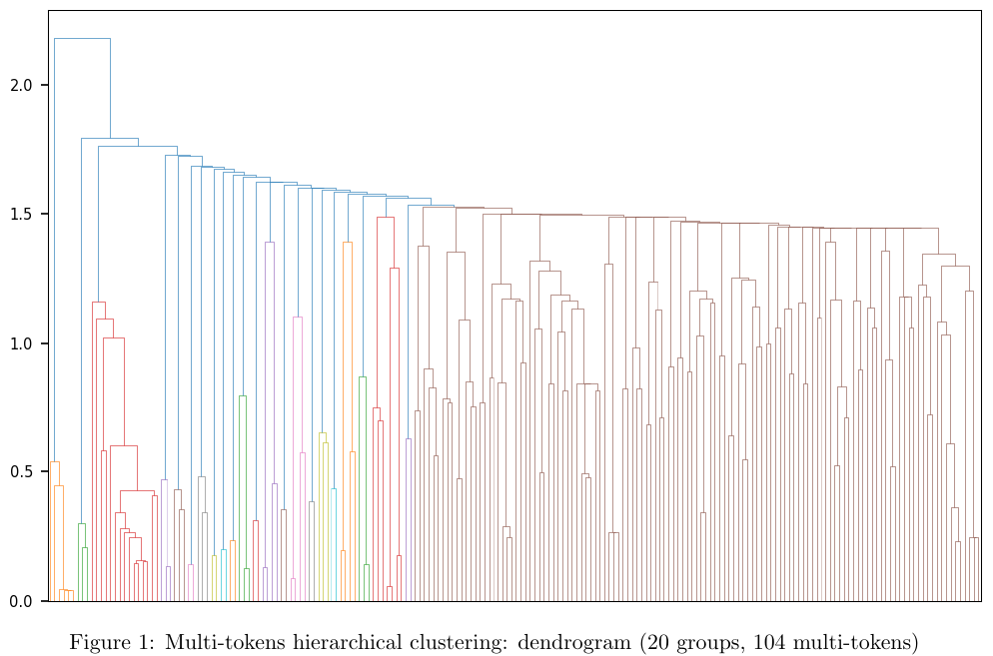
Dendrogram for Multi-Token Clusters

Slide 22
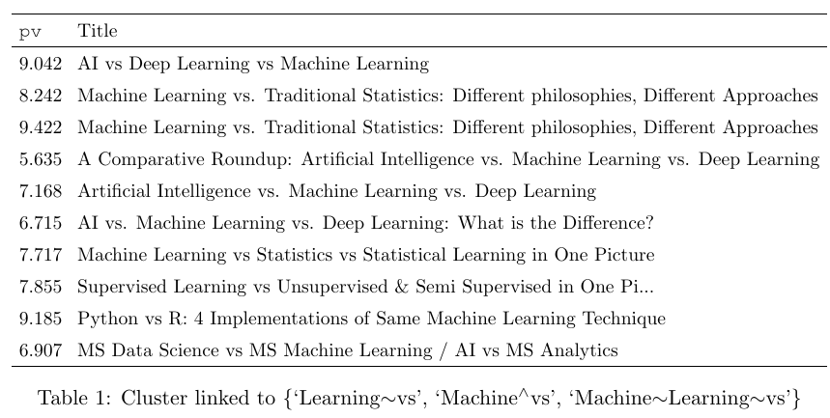
Sample Cluster of Popular Articles
Linked to multi-token cluster with 3 elements, including one contextual multi-token: “Machine^vs” (pv stands for normalized pageview)

Slide 23
Future Research
Using model evaluation metric as loss function
Goal: increase quality, as standard loss functions are poor proxies to model evaluation
Feasible for supervised learning (predictions), not unsupervised (LLM, clustering)
Challenge: computationally impossible for good evaluation metrics such as multivariate Kolmogorov-Smirnov distance (KS)
Solution: use Hellinger distance as loss function; start with rough approximation that increases in granularity and converges to evaluation metric (Hellinger) over time
Thus, loss function changes over time; called adaptive loss function.
Unlike KS, easy to make billions of atomic changes in Hellinger distance (weight updates or neuron activations). Useful when dealing with billions of weights or tokens.

Slide 24
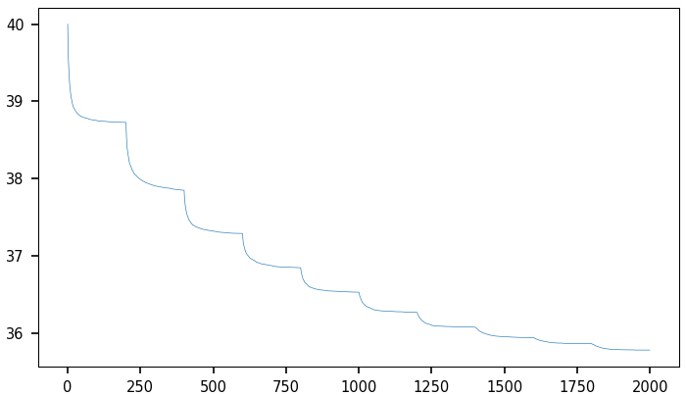
Future Research – Adaptive Loss Function
Refine loss function when it stops decreasing to avoid getting stuck in local optimum: see picture, with 10 change points (Y-axis = loss, X-axis = iterations)

Slide 25
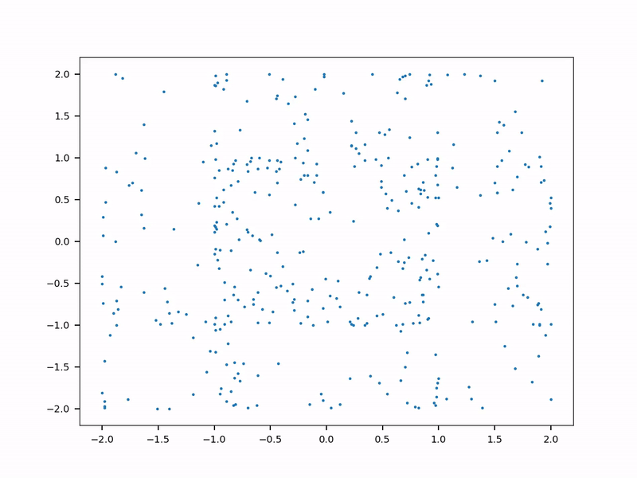
Adaptive Loss Function – Example
Tabular Data Synthetization
Real data: 2 concentric circles
Synthesized, NoGAN synthesizer: blue dots. Constrained synthetization to keep loss above some threshold
As the loss function gets more granular, the synthesized data gets more similar to the real data (the training set)

Slide 26
Final Notes
Classic LLMs (powered by deep neural networks)
Billions of weights, most never used to answer a prompt
Waste of resources, lots of noise in tokens, may produce hallucinations
User pays by the token: expensive
Initially used to predict next token in a sentence
xLLM
Fast, no training, no latency, explainable AI, secure
Does not need prompt engineering
Not relying on unpredictable Blackbox Python libraries
Open source, made from scratch, great for search, easy to fine-tune

Slide 27
References
Main book: “State of the Art in GenAI & LLMs – Creative Projects, with Solutions”, available here.
Project 2.4 – Adaptive loss function
Project 7.2 – Main part, includes smart crawling and x-embeddings
Project 8.1 – Fast approximate nearest neighbor search
Project 8.2 – Evaluation using taxonomy
Project 8.3 – xLLM for clustering and predictions
Appendix C3 & C4 – Comparing xLLM to classical LLMs
On GitHub
xLLM repository, here. Includes code and backend tables.
Newsletter and resources: sign up here.

